Slide 1
First course of Computer Science
Part VIII: Internet - Connect you with the world

Slide 2
Goals
Know the brief history of Internet
The related IO devices
Mechanism
Architecture of UIMS – User Interface Management System

Slide 3
Internet
ts

Slide 4
History of the Internet
Slides created by Ajay Gopinathan. Content adapted from previous slides by Emir Halepovic as well references found at the end of this presentation

Slide 5
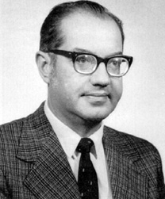
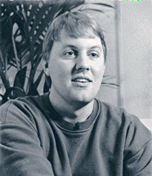

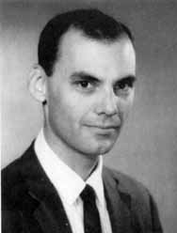

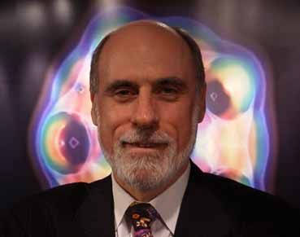
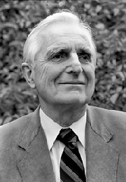
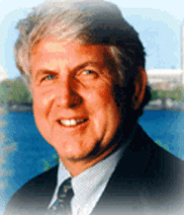
Who are they?

Slide 6
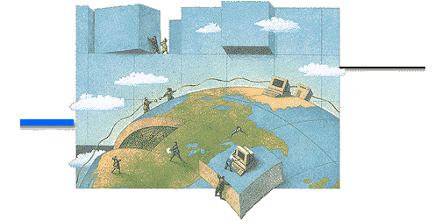
Outline
The Birth of Internet
Internet Pioneers
ARPA & ARPANET
Switching Network
Growth of the Internet
Who governs the Internet
The development in China
The Future Prospects

Slide 7
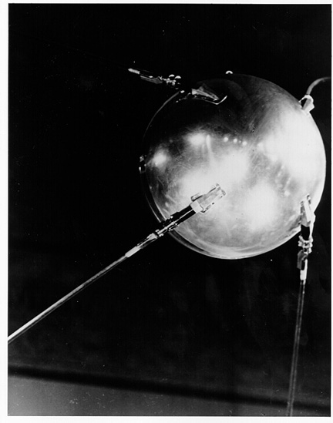
The Birth of ARPA
In 1957, USSR launches the first artificial earth satellite - Sputnik.
In 1958, US forms the Advanced Research Projects Agency (ARPA)
ARPA directly reports to the US Department of Defense (DoD) and develops state-of-the-art technology in order to maintain the leading military research position.

Slide 8
The evolution of ARPAnet
The 1st Packet-Switching (PS) paper was presented in 1961.
PS-network was presented to the ARPA in 1968. The request for the proposals of ARPA Network (ARPANET) was sent in the same year.
In 1969, the ARPANET commissioned by DoD for research into networking.
Only 4 nodes comprise the ARPANET.

Slide 9
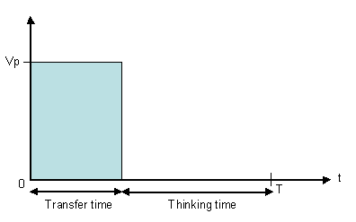
Packet Switching
Data traffic is bursty – intervals of activity followed by periods of inactivity.
E.g. Think of a web browsing session
Circuit switched networks would be inefficient
Image Source: CEFRIEL, Milan

Slide 10
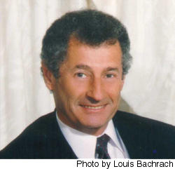
Packet Switching
1961: Leonard Kleinrock uses queuing theory, proposes packet switched networks
More bandwidth efficient
Robust – not reliant on single route
Image Source: Leonard Kleinrock's homepage, http://www.cs.ucla.edu/~lk/

Slide 11
Packet Switching or Circuit Switching?
Circuit Switching
A network that provides data channels for the sole use by a single user.
Packet Switching
Message is broken into pieces of data and is transmitted over the network.
Demo now!

Slide 12
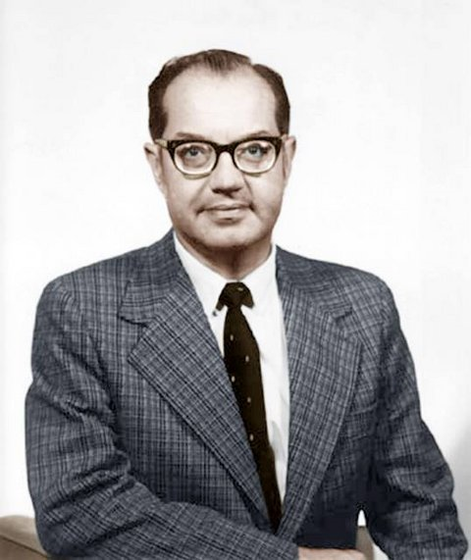
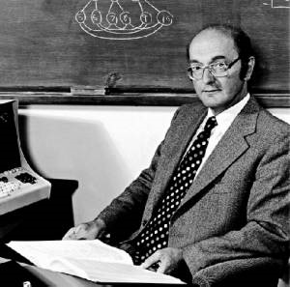
The fundamental mechanism of the Internet
Two concepts
“Store and Forward” (Baran) & “Packet-switching” (Davies)
Paul Baran
Donald Watts Davies, 1924-2000
http://www.techcn.com.cn/index.php?doc-view-130901
http://www.cs.rhul.ac.uk/Studying/ug/daviesscholarship.html

Slide 13
Packet switching [包交换]
At sender, split the message into data blocks
By adding head info, each data block turns into packet
Send the packets to receiver
split the Receiver collects packets, and reverts them into the message
Message
Sender
11010011101 • • • • • • • • 00101001110
Data
Head
Data
Head
Data
Head
packet
packet
Packet
send
Send
Send
Front
Data
Head
Data
Head
Data
Head
Receiver
Data
Data
Data
11010011101 • • • • • • • • 00101001110

Slide 14
Transmitting a packet from A to B following Store & forward
Router table
Router table
Destination Next router
Destination Next router
Router table
router
A
Destination Next router
network
network
router
network
router
network
network
router
router
router
network
network
B

Slide 15
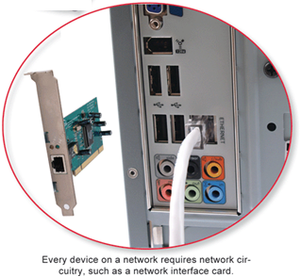
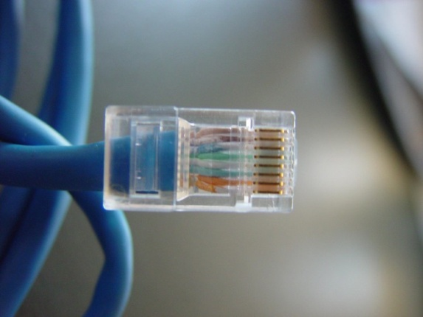
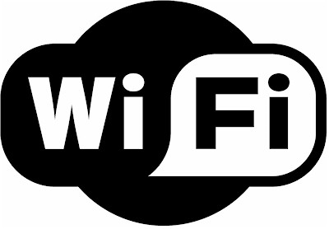
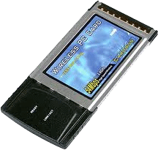
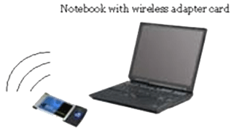
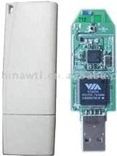
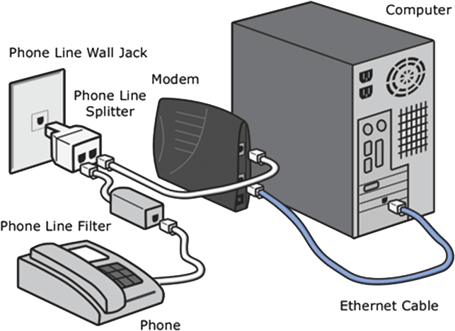
By the above knowledge, computers are just the nodes to be connected into the Internet
To a router of a LAN, MAN, or WAN
Twisted pair
Wireless
Modem (Phone/cable)

Slide 16
The first ARPANET
Nodes are connected by AT&T 50kbps lines.
Node 1: University of California Los Angeles (UCLA), Host is SDS SIGMA7
Node 2: Stanford Research Institute (SRI), Host is SDS940
Node 3: University of California Santa Barbara (UCSB), Host is IBM 360/75
Node 4: University of Utah, Host is DEC PDP-10

Slide 17
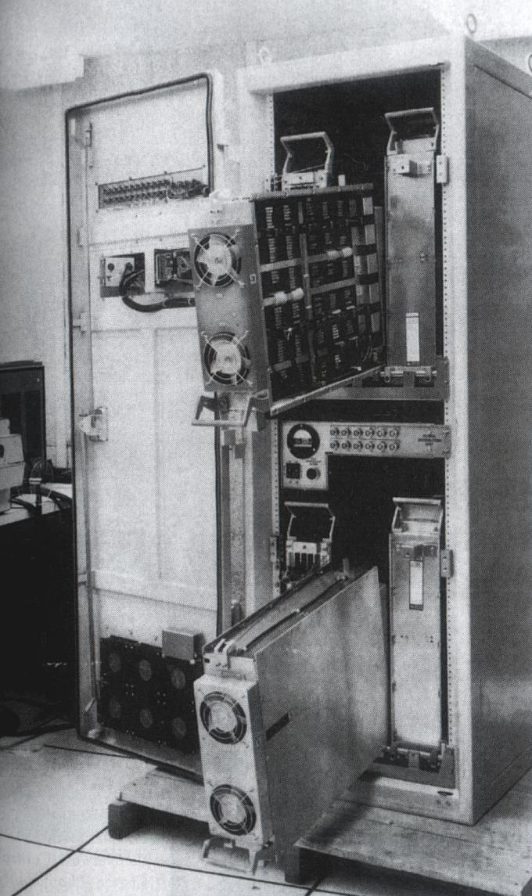
ARPANET
1967: Lawrence Roberts of ARPA publishes plan for the first computer network system – the ARPANET
Packet switches were needed. Called Interface Message Processors (IMP), the contract was awarded to BBN
Oct 1969: IMPs installed in UCLA, Stanford, UCSB and Utah
Interface Message Processor
Image Source:http://aleph.llull.net/wp-content/files/imp.jpg

Slide 18
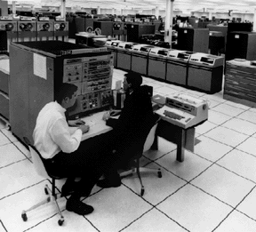
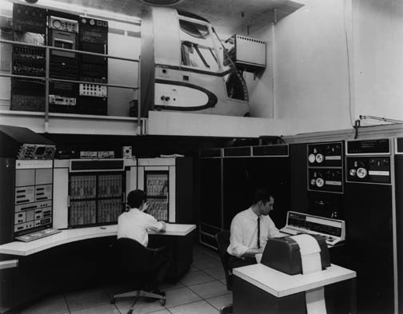
Hosts
IBM 360/75 DEC PDP-10

Slide 19
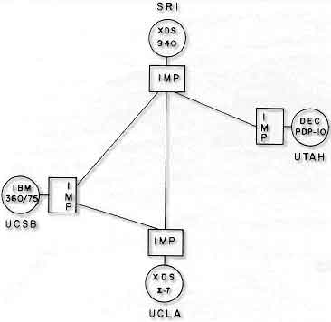
ARPANET
1969: At UCLA Kleinrock attempts the first ever remote login at Stanford:
"We set up a telephone connection between us and the guys at SRI...," Kleinrock said in an interview: "We typed the L and we asked on the phone,
"Do you see the L?"
"Yes, we see the L," came the response.
"We typed the O, and we asked, "Do you see the O."
"Yes, we see the O."
"Then we typed the G, and the system crashed"...

Slide 20
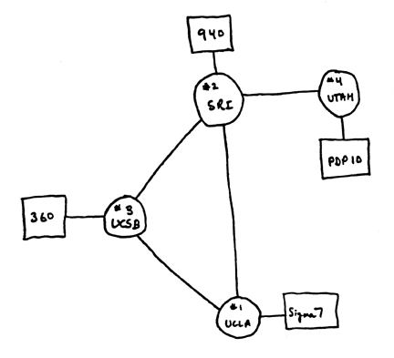
Diagram of the 4-nodes ARPANET

Slide 21
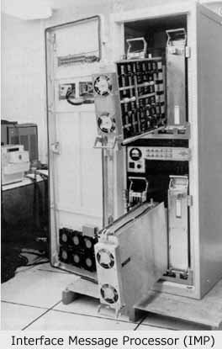
Interface Message Processor (IMP)
4 IMPs were connected, ARPANET was born.

Slide 22
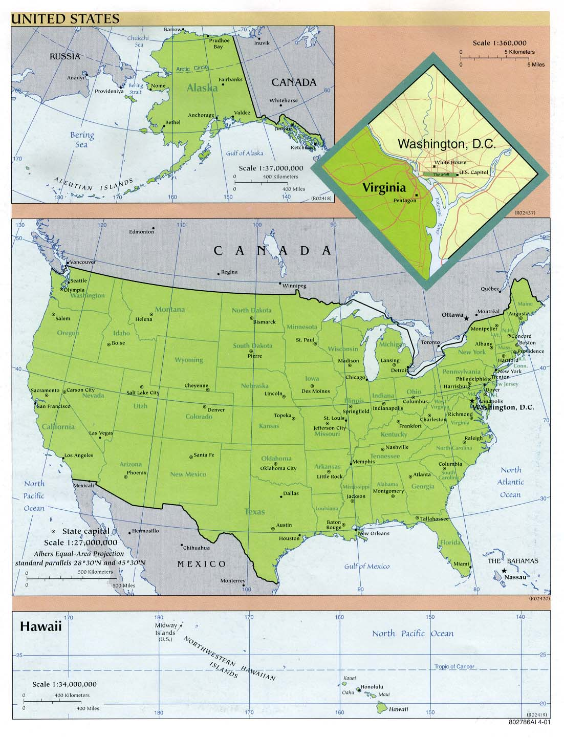

Geographical Position
Host 1(UCLA)
Host 2 (SRI)
Host 3 (UCSB)
Host 4 (Utah)

Slide 23
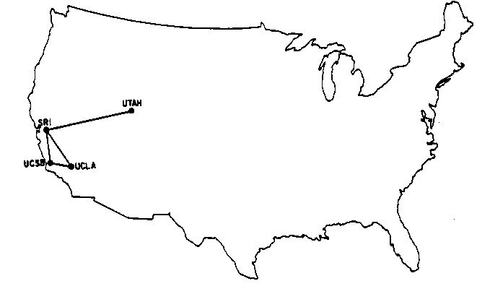
Geographical Position

Slide 24
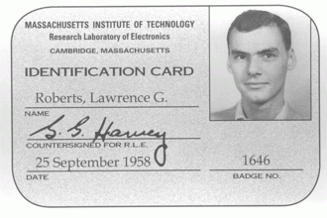
The father of ARPANET
Larry Roberts is the principal architect of the ARAPNET

Slide 25
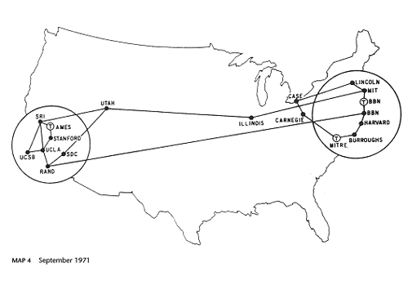
The growth of ARPANET
1971, 15 nodes (23 hosts): UCLA, SRI, UCSB, Univ of Utah, MIT, Harvard, Stanford, UIUC, CMU, NASA, etc…

Slide 26
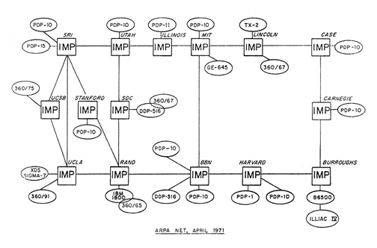
The growth of ARPANET
1971, 15 nodes (23 hosts): UCLA, SRI, UCSB, Univ of Utah, MIT, Harvard, Stanford, UIUC, CMU, NASA, etc…

Slide 27

The growth of ARPANET
Ray Tomlinson invents email program (1971), introduce the use of “@”.
ALOHAnet (first packet radio network) from Univ of Hawaii, join ARPANET in 1972.
1973, study shows email compose 75% of the ARPANET traffic.
Elizabeth II sent an email in 1976.

Slide 28
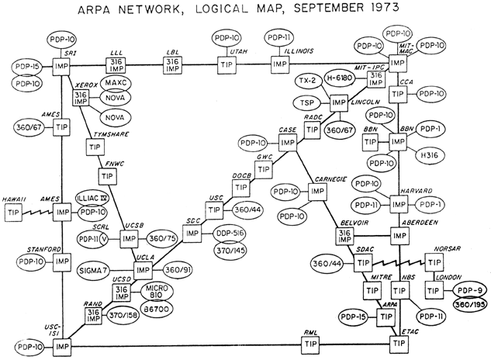
The ARPANET - 1973

Slide 29
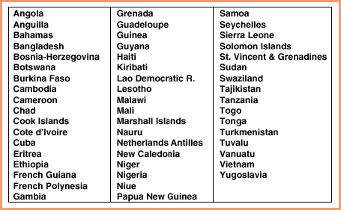
Figure 10.1 Countries in 1977 that could send or receive email but were not connected to the Internet.

Slide 30
Early 70s...
ARPANET, with 40 nodes, goes public in 1972
NCP, first host-to-host protocol, enables network applications
1972: Ray Tomlinson writes email program for ARPANET
First computer to computer chat takes place between Stanford and BBN
1972: Telnet protocol RFC published
1973: FTP protocol RFC published

Slide 31
Ethernet
ARPANET – Each node able to only talk to the other node on the other end of wire
First medium access control – ALOHANet by Norman Abramson
1973-75: Bob Metcalfe's dissertation leads to the Ethernet protocol
Medium access control protocol for wired networks based on Abramson's ALOHA.
Dissertation initially rejected by Harvard for not being analytical enough, but won acceptance when a few more equations were added!

Slide 32
Proprietary Networks
ARPANET was a standalone network. Other proprietary, standalone networks were created in the 70s:
ALOHANET: Linking Hawaiian universities, using microwave as transmission medium
Telenet: by BBN, commercial
Cyclades: French packet switching network
Number of networks was growing!

Slide 33
Late 1970s, Early 1980s
Many networks were built
In 1981, BITNET, the “Because It’s Time NETwork” started as cooperative network.
CSNET (Computer Science NETwork) seeds grant support by National Science Foundation (NSF) and provides connection between universities.
EUnet (European UNIX Network)
JUNET (Japan UNIX Network)
JANET (Joint Academic Network) in UK

Slide 34
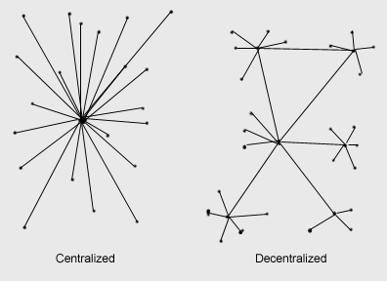
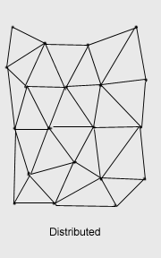
Why Decentralized? Why Distributed?
Centralized model – attack the central point, any counter-attack?

Slide 35
Distributed Network
Paul Baran has 2 important ideas to the development of ARPANET
Distributed network
Packet switching

Slide 36
NSFNET
In 1986, NSFNET was created (backbone speed of 56Kbps)
Connected 5 supercomputing centers.
JVNC@Princeton
PSC@Pittsburgh
SDSC@UCSD
NCSA@UIUC
Theory Center@Cornell

Slide 37
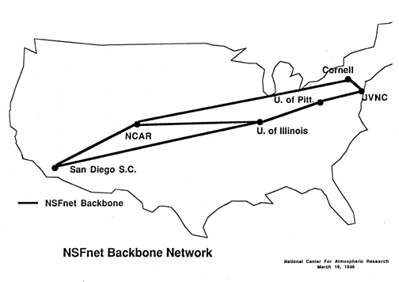
NSFNET - Backbone

Slide 38
Expansion of hosts
Number of hosts breaks 10,000 in 1987
NSFNET backbone upgraded to T1 (1.5M) 1988
Number of hosts breaks 100,000 in 1989
NSFNET upgraded to T3 (44.736Mbps) 1991
Number of hosts breaks 1,000,000 in 1992

Slide 39
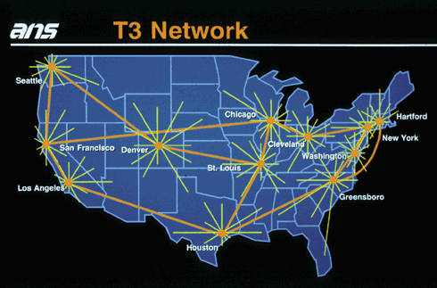
T3 Backbone

Slide 40
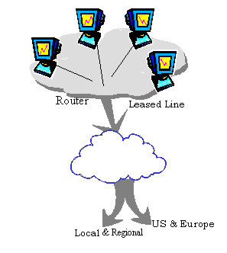
Trunk Bandwidth
T1 – Trunk Level 1
A T3 line is comprised of 28 T1 lines, each operating at total signaling rate of 1.54 Mbps.
T1 – 1.5Mbps, T2 – 6Mbps, T3 – 45Mbps
European Standard – E
E1 – 2Mbps, E2 – 8Mbps, E3 – 34Mbps, E4 – 140Mbps

Slide 41
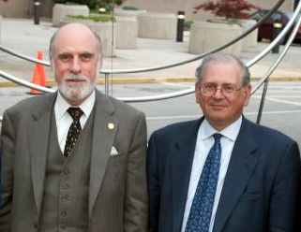
Fathers of the Internet
At DARPA, Vinton Cerf and Robert Kahn are working on an architecture to create a “network of networks” - internetting!
Vinton Cerf and Robert Kahn
Image Source: http://www.adeptis.ru/vinci/kan_cerf.jpg

Slide 42
“Internetting” principles
Decentralized control
Stateless routers
Autonomy - networks should be independent, require no modification to participate in the Internet
Best Effort Service Model - Packets would be routed through the fastest available route

Slide 43
TCP and UDP
Early versions had in sequence delivery (transport layer) combined with forwarding (network layer)
It was soon apparent that unreliable, non-flow controlled service was important, e.g. packetized voice
This led to separation of TCP and IP and creation of the UDP protocol.
“TCP over IP”

Slide 44
1980s
Time of tremendous growth
Networks for linking universities together
BITNET – email and ftp (Northeast)
CSNET – linking universities without access to ARPANET
NSFNET: provide access to NSF supercomputing resources
1983: TCP/IP replaces NCP as universal host protocol on Jan 1.
By the end of the 80s, there were 100,000 hosts

Slide 45
1990s...commercialization!
NSFNET began to serve as backbone, linking regional networks in US and networks abroad
ARPANET was decommissioned
NSFNET was decommissioned in 1995, most Internet backbone traffic carried by commercial ISPs
Increased commercialization, advent of WWW, all lead to explosion of growth

Slide 46
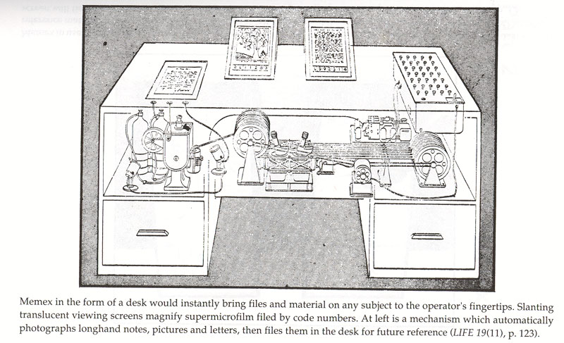
The Memex
1945: Vannevar Bush's essay, “As We May Think”, envisaged the memex, a device that was linked to books and films in the library
Able to follow cross-references from one resource to another - hypertext!

Slide 47
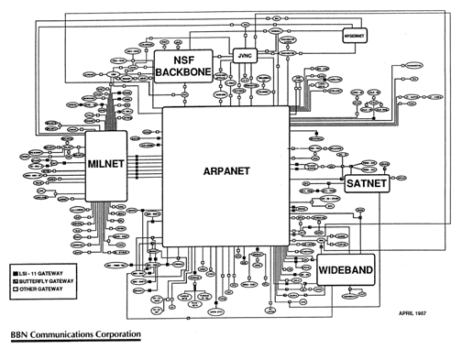
The Internet - 1987

Slide 48
The emergence of the Internet
Department of
Defense
(DoD)
National Science
Foundation
NSF
Other
Funding
CSNET
BITNET
ARPANET
NSFNET
JANET
MilNET
Internet
ALOHANET

Slide 49
The father of the Internet
Vint Cerf defines the network protocol and breaks the independent self-contained networks, forms TCP/IP which becomes the standard

Slide 50
Networking Technology
Local Area Network (LAN)s are very popular in 1980s, especially in Universities.
Many workstations were connected by Ethernet which was invented by Bob Metcalfe

Slide 51
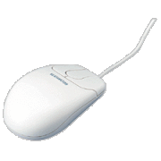
Who creates Mouse?
Can you surf without the use of mouse?
We should thank Douglas Englebart for his invention.

Slide 52
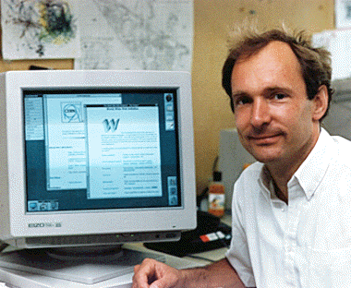
The Invention of WWW
The World Wide Web (WWW) was created by Tim Berners-Lee at European Laboratory for Particle Physics (CERN) in 1991
Together with Robert Cailliau wrote the first WWW client and server

Slide 53
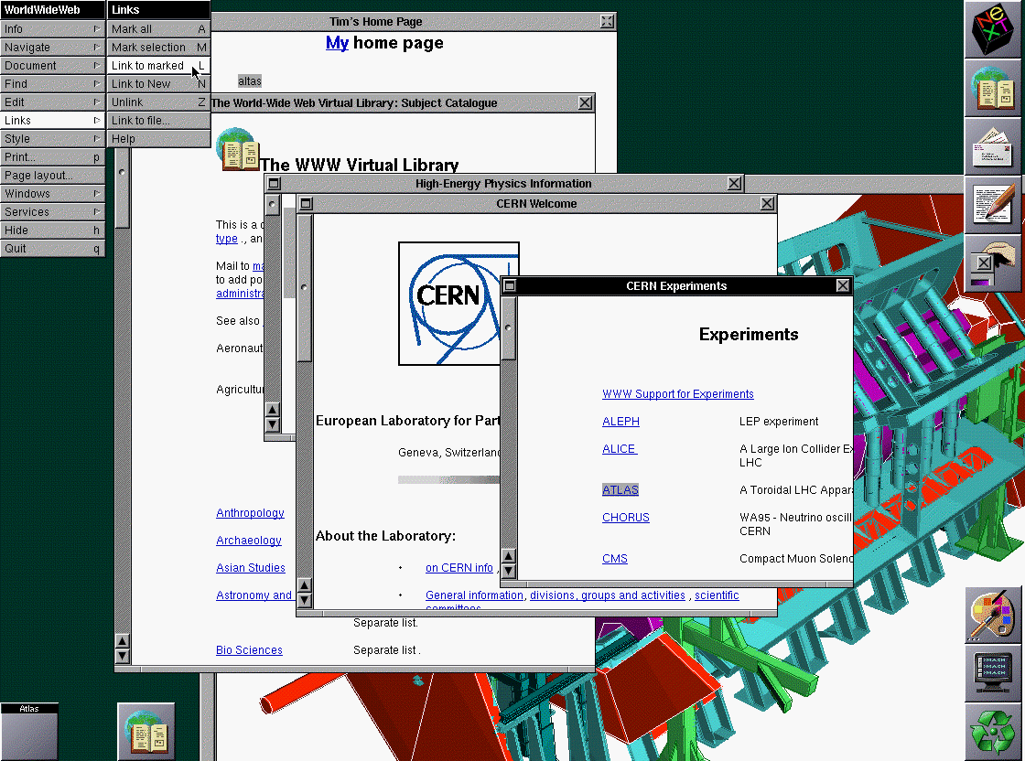
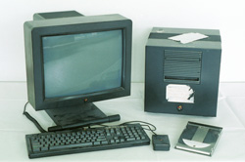
The World Wide Web
Tim Berners-Lee marries hypertext to the Internet, and invents the WWW (1991)
HTTP protocol, web browser, web server, web page
The historic NeXT computer used by Tim Berners-Lee in 1990, on display in the Microcosm exhibition at CERN. It was the first web server, hypermedia browser and web editor.
Image Source:http://www.w3.org/History/1994/WWW/Journals/CACM/screensnap2_24c.gif
Image Source:http://info.cern.ch/

Slide 54
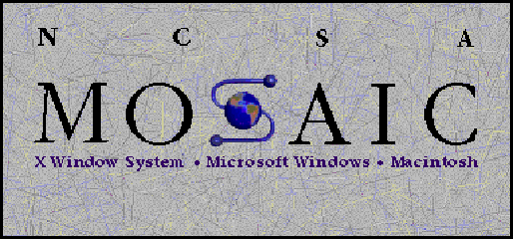
Browser evolution
Mosaic takes the Internet, 1993
A graphical WEB browser, WWW client which was released by Marc Andreesen at NCSA (National Center for Supercomputing Applications) in the University of Illinois in Urbana-Champaign (UIUC)
Netscape, 1994
Marc Andreessen and Jim Clark
1996, 75% uses Netscape
It was bought by America Online in 1999 (10 Billion in stock)

Slide 55
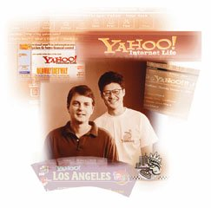
Billionaire – Jerry Yang
David Filo & Jerry Yang started Yahoo when they were doing their PhD studies at Stanford University in 1994
Yahoo is one of the famous search engine on the NET.

Slide 56
Internet Worm
In 1988, Robert Morris, graduate student in Computer Science at Cornell, wrote an experimental, self-replicating, self-propagating program “a worm”
Distribute itself to over 6,000 of the 60,000 computers that were on the Internet at that time.
He was sentenced to 3 years of probation, 400 hours of community, a fine of $10,050.

Slide 57
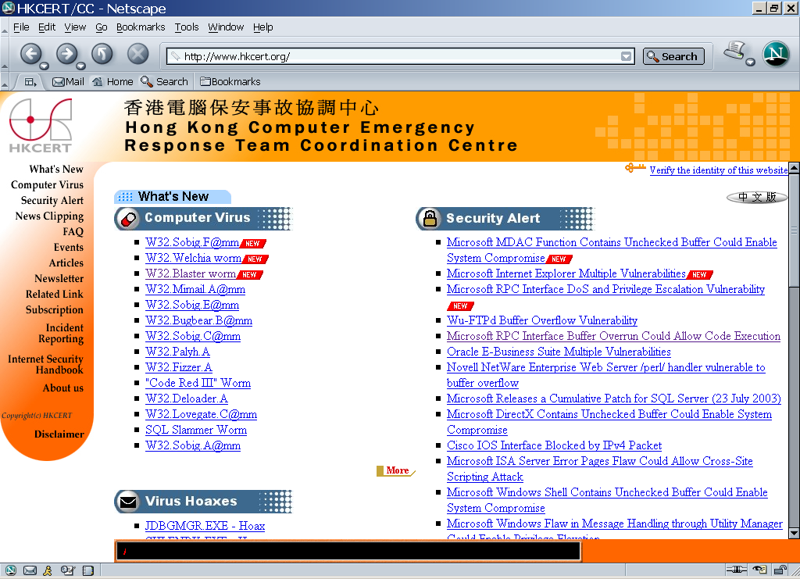
Recent Threats

Slide 58
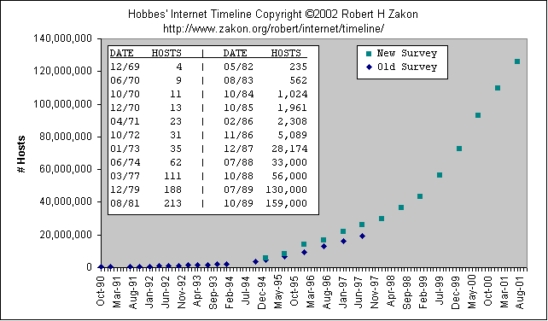
Growth of the Internet Hosts

Slide 59
Some Statistics
At January 2000, there are 72,398,092 hosts connecting to the Internet.
At June 2000, there are 17,119,262 web servers.
At July 1997, there are 1,301,000 domains.
At July 1997, there are 171 countries connecting to the Internet.

Slide 60
Interesting Facts
25,000 new users daily
325 million users (October 2000)
50% of users are female
73 million hosts (October 2000)
200+ countries connected
World Wide Web sites double every two months

Slide 61
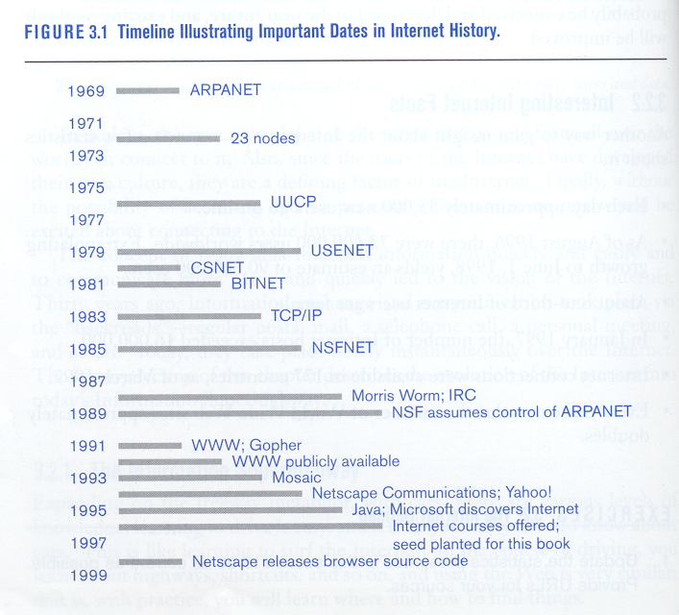
Internet History

Slide 62
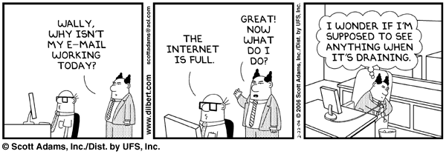
Internet Growth
The Internet may not be full, but it has grown at a phenomenal rate!

Slide 63

Growth of the Internet Networks

Slide 64

Growth of the Internet Domains

Slide 65

Growth of the Internet Web Sites

Slide 66

Internet Growth: Hosts

Slide 67

Internet Growth:WWW sites

Slide 68

Internet Growth: Domains

Slide 69

Internet Growth: Users

Slide 70

An example global backbone network

Slide 71

Many media are used to build networks which cover different regions
First is the WAN – cover the continents or a country

Slide 72

Internet Map
http://en.wikipedia.org/wiki/Image:Internet_map_1024.jpg

Slide 73


Who governs the Internet?
NOBODY!!
Internet Society (ISOC)
Professional membership society
World Wide Web Consortium
develops technologies (specifications, guidelines, software, and tools)
Internet Network Information Center (InterNIC)
Domain registration

Slide 74


Who governs the Internet?
Internet Corporation for Assigned Names and Numbers (ICANN)
responsibility for the IP address space allocation, protocol parameter assignment, domain name system management, and root server system management
Internet Engineering Task Force (IETF)
a large open international community of network designers, operators, vendors, and researchers

Slide 75

Who governs the Internet?

Slide 76




Who manages IP address?
Internet Assigned Numbers Authority (IANA)
APNIC (Asia-Pacific Network Information Center)
Asia Pacific
ARIN (American Registry for Internet Numbers )
North America, South America, the Caribbean and sub-Saharan Africa.
RIPE NCC (Réseaux IP Européens)
Europe, Middle East, parts of Africa

Slide 77
The Internet Development in China
Sept, 1987 – a professor in Beijing sends out the first email in China
Oct, 1990 – China registers the country’s domain name “cn” at InterNIC
Sept, 1994 – China Telecom signs an agreement to open two 64K lines in Beijing and Shanghai
Jan, 1996 – China Public Computer Internet (CHINANET) opens
Jun, 1999 – 1.46 million computers connected to the Internet and 4 million Internet subscribers, 29,045 .cn domain names and 9,906 web sites
Nov, 2002 – 145,427 .cn domain names, …

Slide 78
An Internet Odyssey
Please suggest what will happen in 2010 to the Internet?
De-Mobilization of Free Expression?
People listening today, more people will be listening tomorrow
Not a substitute for communicating with people
Still expanding very fast – IPv6!

Slide 79

References
Hobbes’ Internet Timeline
Internet Pioneers
Zen and the art of the Internet
Life on the Internet
China NIC
Berners-Lee, Tim. (1999). Weaving the Web. San Francisco: HarperCollins.
Class Exercise:
Question: What is Internet2?

Slide 80

The End
Thank you for your patience!
Source:"A History Of The Internet: 1962-1992", by The Computer Museum (TCM)

Slide 81
References
“Internet History”, Gregory Gromov, http://www.netvalley.com/cgi-bin/intval/net_history.pl?chapter=1
A Brief History of the Internet, Walt Howe, http://www.walthowe.com/navnet/history.html
History of the Internet, Internet for Historians, Richard T. Griffiths, http://www.let.leidenuniv.nl/history/ivh/frame_theorie.html
Hobbes' Internet Timeline, Robert Hobbes Zakon, http://www.zakon.org/robert/internet/timeline/
CPSC 641 Lecture Slides - – Introduction, Networking Terminology and Intenet Evolution, Carey Williamson, http://pages.cpsc.ucalgary.ca/~carey/CPSC641/
CPSC 441 tutorial slides, Emir Halepovic

Slide 82
Reference
The History of the Internet
http://www.isoc.org/internet/history/cerf.shtml
http://www.walthowe.com/navnet/history.html
Timeline
http://www.zakon.org/robert/internet/timeline/
http://www.isoc.org/internet/history/2002_0918_Internet_History_and_Growth.ppt
Al Gore invented the Internet?
http://www.eecs.umich.edu/~fessler/misc/funny/gore,net.txt
http://sethf.com/gore/
Who is managing the Internet?
http://www.acm.org/ubiquity/views/v6i5_simoneli.html

